Slide 1


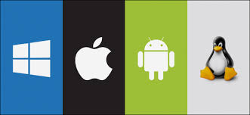
Introduction: Operating system and functions Session No.: 1 Course Name: Operating System Course Code: R1UC403B Instructor Name: Dr. Anjali Kapoor Duration: 50 min Date of Conduction of Class:

Slide 2
At the end of this Prerequisites n students will be able to
Understanding of hardware components (CPU, RAM, storage, I/O devices) with real examples.
CPU (Central Processing Unit): The brain of the computer that processes instructions. When you open a spreadsheet and perform calculations, the CPU processes these operations.
RAM (Random Access Memory): While editing a document, the data is loaded into RAM for fast access, allowing for real-time changes.
Storage: Saving photos, videos, or documents on a hard drive or SSD ensures they remain accessible for future use.
I/O Devices (Input/Output Devices): Typing on a keyboard (input) allows you to write an email, and viewing it on a monitor (output) lets you read it before sending.
Notes:
including process management, memory management, file system management, and device management.

Slide 3
Question based on prerequisites
Q If you are playing a game on your computer, how does the CPU, RAM, and storage work together?
Q If your computer is running slowly while working on multiple applications, which hardware component is likely the issue? Why?

Slide 4
At the end of this session you will be able to
Learning Outcome 1: Define and describe the fundamental concept of an Operating System.
Learning Outcome 2: Comprehend the key functions of an Operating System.
Notes:
including process management, memory management, file system management, and device management.

Slide 5
Session Outline
1. Definition of Operating System
2. Activity 1
3. Functions of Operating System
4.Activity 2
5. Conclusion.
6. Closure and Post activity..

Slide 6

Opening Question :
Suppose Indian tourists have visited to France/Spain/Turkey/Russia (or any other non-English country). The moment they land at the airport, what will be the first problem they will be facing?
Notes:
👉 Language barrier
So what is the solution?
Students may say:
Translator
Google Translate
Local guide
Interpreter

Slide 7
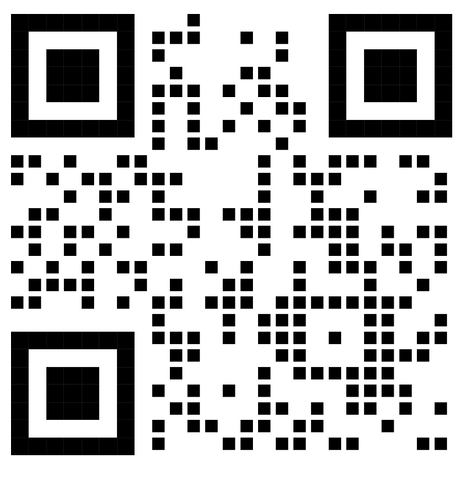

WHAT IS AN OPERATING SYSTEM?
Activity-1
https://www.youtube.com/watch?v=fkGCLIQx1MI
What do you Understand from the video? What is an Operating System? What Can it do?

Slide 8

WHAT IS AN OPERATING SYSTEM?

Slide 9

Four Components Of Computer System
Notes:
It provides programs an environment to execute.
It provides users the services to execute the programs in a convenient manner.

Slide 10
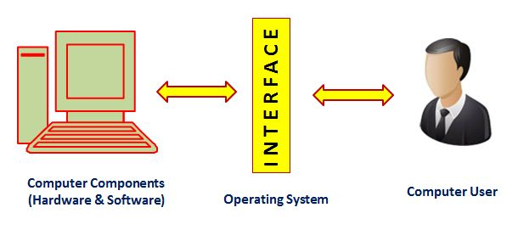
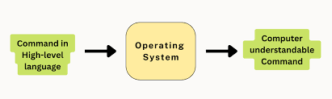
Reflect on the responses of post session activity
What is an Operating System?
An Operating System is a program that acts as an intermediary/interface between a computer user and the computer hardware.
Operating system goals:
Execute user programs and make solving user problems easier.
Make the computer system convenient to use.
Use the computer hardware in an efficient manner.
Engaging Questions:
List the names of Operating systems you have used :(Wordcloud)

Slide 11
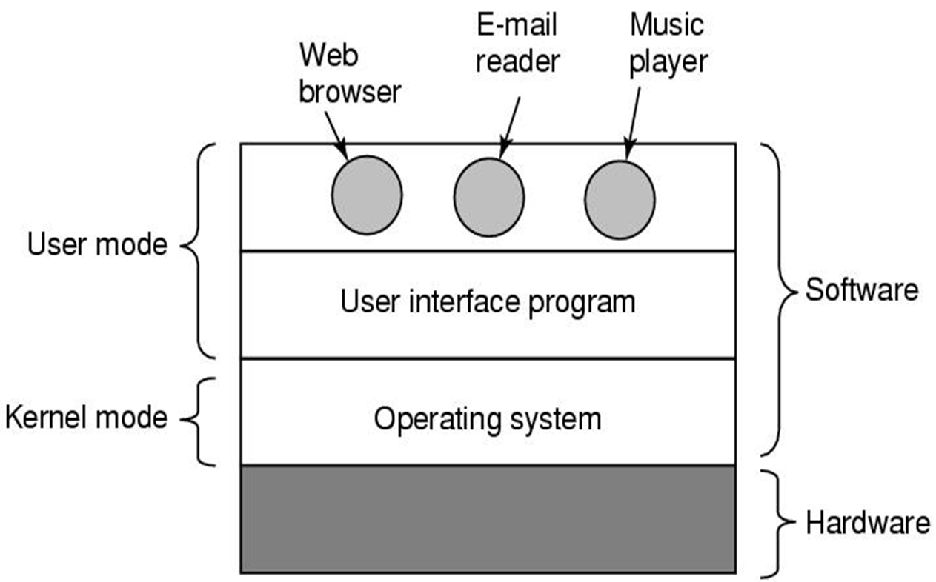
Where does the OS fit in?
Notes:
The kernel serves as the bridge between the OS and hardware..
Kernel mode is a processor mode that gives the operating system access to the hardware and system data.
In user mode, applications run with limited privileges to prevent direct access to hardware, ensuring system stability.
In kernel mode, the operating system has unrestricted access to all hardware resources, enabling it to perform critical tasks such as memory management and process control.

Slide 12
Why are Operating Systems Important?
Operating Systems (OS) are crucial for the efficient functioning of computers and other digital devices.
Without an OS, using a computer would require direct interaction with hardware, making it complex and inefficient.

Slide 13
Functions of Operating System
Process Management
Creates, schedules, and terminates processes.
Handles process synchronization and inter-process communication.
Allocates and deallocates system resources to processes.
2. Memory Management
Allocates and deallocates memory space for processes.
Implements memory management techniques like paging and segmentation.
Manages virtual memory for efficient multitasking.
3. File System Management
Organizes, stores, retrieves, and manages data in files and directories.
Controls access permissions and ensures file security.
Manages file operations like creation, deletion, and modification.

Slide 14
Functions of Operating System
4. Storage Management
Manages storage devices like HDDs, SSDs, and external drives.
Ensures efficient data organization using file systems (e.g., NTFS, FAT32, ext4).
Controls disk space allocation and deallocation.
Implements disk scheduling algorithms (e.g., FCFS, SSTF, SCAN).
5. Cache Management
Allocates and deallocates memory space for processes.
Implements memory management techniques like paging and segmentation.
Manages virtual memory for efficient multitasking.
6. I/O System Management
Manages input and output devices efficiently.
Ensures smooth data transfer between devices and the system.
Provides device independence by abstracting hardware complexities.

Slide 15
Functions of Operating System
7 Device Management
Organizes, stores, retrieves, and manages data in files and directories.
Controls access permissions and ensures file security.
Manages file operations like creation, deletion, and modification.
8. Security and Access Control
Protects data and resources from unauthorized access.
Implements authentication and encryption mechanisms.
Prevents malware attacks and ensures system integrity.
9. User Interface Management
Provides Command-Line Interface (CLI) and Graphical User Interface (GUI).
Facilitates user interaction with the system.
10. Networking Management
Supports communication between devices using network protocols.
Manages data transfer over the internet or local networks.

Slide 16
Functions of Operating System
10. Error Detection and Handling
Detects and responds to hardware and software failures.
Logs errors and ensures system stability.
11. Job Scheduling and Resource Allocation
Assigns CPU time and system resources to different processes.
Uses scheduling algorithms (FCFS, Round Robin, etc.) for task execution.

Slide 17

Group 1: 1.5.1 Process Management- Page 27(55)
ACTIVITY 2: Group Discussion: https://drive.google.com/file/d/1_KHrZe5oO3R-QY26byPVfZN0oqtGfbi1/view?usp=drive_link
Group 2: 1.5.2 Memory Management Page 28 (56)
Group 3: 1.5.3 File-System Management Page 29 (57)
Group 4: 1.5.4 Mass-Storage Management Page 30 (58)
Group 5: 1.5.5 Cache Management Page 30 (58)
Group 6: 1.5.6 I/O System Management Page 32 (60)

Slide 18
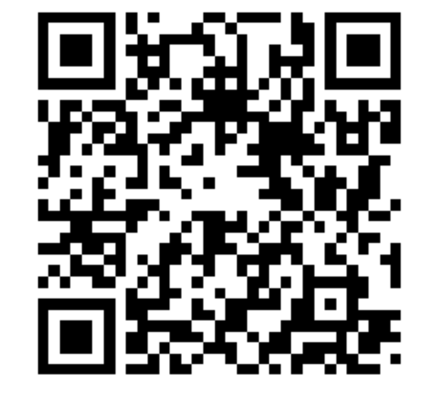
Activity 2: Functions of Operating system: Woo clap
Notes:
When you open multiple applications like a web browser, word processor, and email client at the same time, the operating system (OS) ensures smooth functioning by managing processes, memory, storage, and hardware resources efficiently
Multitasking & Process Management: The OS assigns CPU time to each running application, switching between them rapidly so that they appear to run simultaneously.
Memory Management: The OS allocates RAM to each application and manages virtual memory if RAM is full, using part of the hard drive as temporary storage.
File Management & Auto-Saving: When you save a document in the word processor, the OS handles file writing, ensuring data is stored securely.

Slide 19
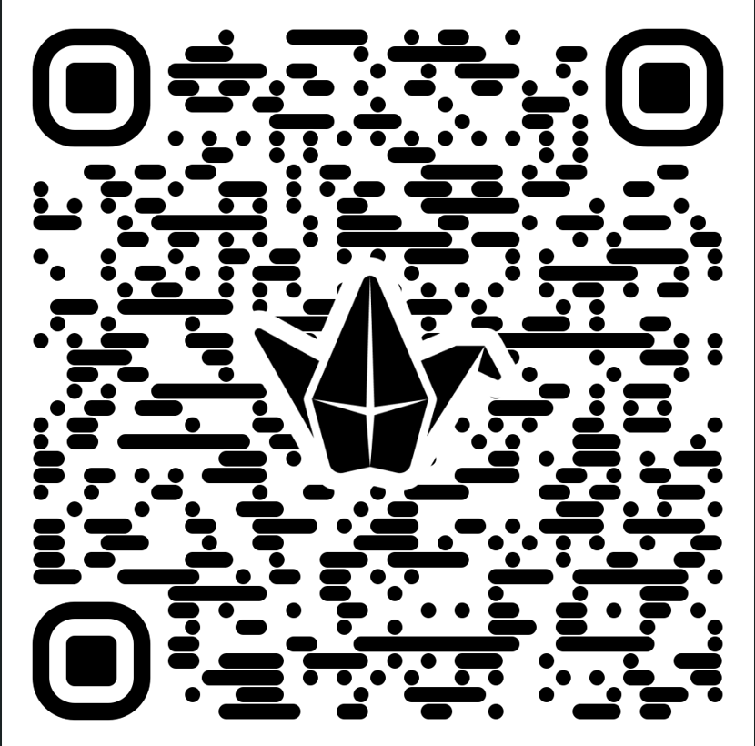
Conclusions (Reflect Key takeaways on Padlet)
What do you think an operating system does?
Can you list any examples of operating systems you are familiar with?
What functions do you think an OS performs
What services do you think an operating system provides to its users and applications (e.g., file management, security, device management)?

Slide 20
Closure
I hope this session has given you a solid foundation for understanding of operating system and its various functions.
Do your post assessment activity
Information about our next class:
We will learn about services of operating system.
Notes:
1 reflection
2 record the proof
3. Post session activity
4. Feedback also.

Slide 21

EXIT TICKET
https://forms.gle/cfUE2GZuQY7MWs9t7

